Slide 1
DevOps Demo Lab
Who, What, Why and How!

Slide 2
Who are we?
A small team of Interop/InteropNet veterans who enjoy researching and detailing new concepts in networking.
We are motivated by the desire for knowledge and the opportunity to share and receive greater understanding through open exchange of information.
We are not DevOps experts. We are Infrastructure experts researching how DevOps can benefit the IT industry.

Slide 3


Glenn Evans Founder and CEO Acrux consulting
Extensive experience in planning, implementing and monitoring network and voice systems for dynamic environments.
International background with projects completed in Asia-Pac, USA, UK and Europe for clients including Interop, Microsoft, Linkedin, Nike, Tableau Software, NetApp, CenturyLink
Detailed understanding of large enterprise environments.
Experience in leading corporate level strategic initiatives.
Strong management background across large and diverse team structures.
Proven ability to build and lead energized and focused teams.
Ability to align business strategies to team goals.

Slide 4

William (WEJ) Jensen Technology Advisor INOC and UW Madison
Over 30 years of experience in networking, engineering, deploying and operating large scale high-speed networks.
An advocate of standards based protocols and importance of interoperability, Bill has been active in helping to move technology forward and improve the user experience in the field. Bill has participated in numerous interoperability tests and live demonstrations of technology in private and public venues including events with the MPLS Forum, University of New Hampshire Interoperability Labs, Interop, InteropNet Labs and Super Computing SCinet. He is also active in standards work including working groups at the IETF.
Bill currently focuses most of his time on engineering activities involving high capacity optical transports and emerging technologies such as SDN and open optical transports. Bill holds a joint appointment with the University of Wisconsin, Madison.

Slide 5


Robert Davis Consultant Cyberdog.co
Robert is a comical techie and entrepreneur. Robert’s expertise is in Network Operations (10 years) and has a lot of experience being a LAMP and Windows sysadmin, including cloud orchestration.
Robert likes judo, cars, electronic music, photography, and food. Robert tries new things whether it be a restaurant, skydiving, travel, or fitness.
In his spare time Robert develops web apps in PHP and Ruby. I enjoy hanging out with friends, petting my cat, and going on drives.
Cyberdog.co is an IT Services company providing consultation services for Networking Infrastructure including IPv6, Windows Server Domain services including DNSSEC, OSX Server, Wireless installations, and Cloud/On-prem Server Management and Monitoring. Also provides dedicated web application hosting solutions for small businesses that require cloud reliability and custom tailored support.

Slide 6

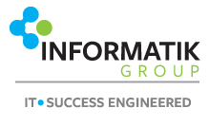
Mark Sullivan Network Engineer / Integration Specialist Informatik Group, LLC
Mark has 25 years designing and implementing complex network infrastructure. Specializing in rapid infrastructure transformation.
Mark assists Private Equity and Venture Capital firms to successfully establish new organizations through acquisition carve-outs and carve-ins for global companies.
Mark understands the challenges companies face in the global marketplace having worked extensively in Europe, Asia, and the Americas.

Slide 7
With Support From…
Curtis Franklin
UBM
InteropNet Alumni
Sharks with Lasers

Slide 8
What Are We Doing?
We have been tasked to provide practical demonstrations of DevOps concepts that exist right now using available tools and experience-built scenarios to understand future capabilities.
We’re demonstrating these tools and systems within the scope of how they can be applied to Infrastructure deployment and management.

Slide 9
Why Are We Doing It?
The days of ‘conf t’ are waning for network engineers, the automation of system management and deployment is the future.
This blurs the lines between traditional network engineer and combines the skills of system administration and developer.
DevOps is going mainstream.
Being prepared will give an individual or organization a competitive advantage.
We thought it may be interesting.

Slide 10
What Is DevOps?
Like most industry terms, DevOps has been hijacked by marketing departments and ‘adjusted’ to match the needs of the vendors’ product or service already in place. Other common examples, “cloud”, “SDN”, “IoT”.
However…
…in practical terms, DevOps is best summed up as “Using code to control and manage systems in an intelligent, highly predictable and repeatable manner.”
DevOps…
…standardizes management and deployment of systems across an organization.
…allows system owners to manage vast amounts of infrastructure with minimal investment in time.
…provides the ability to adapt to operational needs based on external factors and demands.
…reduces risk by standardizing and automating procedure and configuration.
…provides easy version control (you can use Git/GitHub for this).

Slide 11
Paradigm Shift!!!
DevOps is a fundamental paradigm shift from traditional ‘conf t’ and ‘conf t’ automation.
Infrastructure configuration will be pushed (or pulled) from a central repository based on pre-defined system conditions or conditions identified (AI) in real-time.
Traditionally organizations keep development, system administration and network engineering at arms length. DevOps blurs the line and requires staff to have complimentary skills.
Systems are now deployed and maintained through the use of centralized management scripts and configurations.
This allows for rapid wholesale roll-forwards and roll-backs.
You are now here
Development
Network Engineering
System Administration

Slide 12
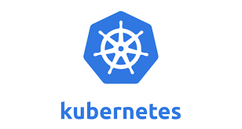

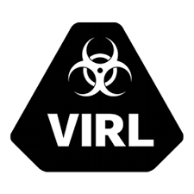
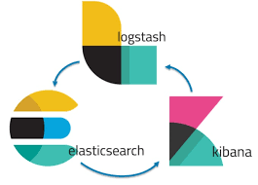
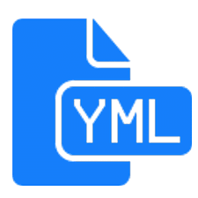

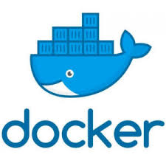
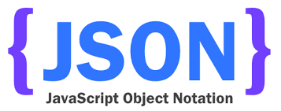
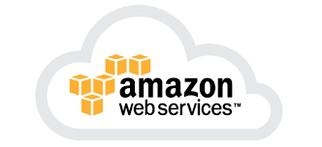


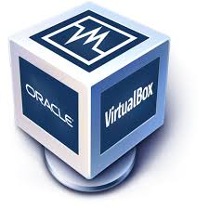
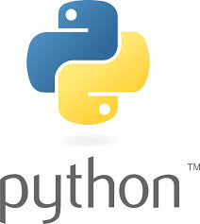

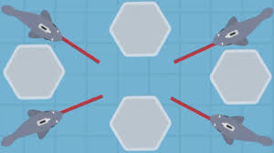
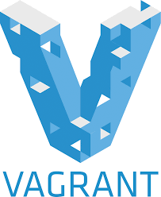

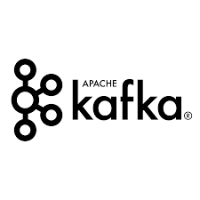

How Are We Doing It?
Oxidized

Slide 15
Tools & Skills – Suggested Path
Previous Programming Experience
Python
netmiko, ciscoconfparse, napalm, textfsm
Data Representation/Serialization
JSON
YAML
Revision Control
Git/GitHub
Linux
No Previous Programming Experience
Ansible
Network Modules, Network Engine
Data Representation/Serialization
YAML
JSON
Revision Control
Git/GitHub
Linux
Ansible will get you started quickly but some basic scripting skills are invaluable and inevitable…
Source: Shamelessly cut/pasted from Claudia le Luna’s excellent presentation | https://github.com/cldeluna/just_enough_na.| claudia@indigowire.net
Notes:
Why Python…
Rich set of modules to help network engineers

Slide 16
Mission Statement
That’s what I love about science, there’s no one right answer.
-Zack Johnson

Slide 17
Mission Statement
Provide practical demonstrations of some of the issues surround DevOps interoperability and utilize concepts being discussed in the Conference tracks in the areas of Security, Infrastructure and Data Analytics.
Break down the complexity by providing demonstrations that illustrate each technical specialty, led by members of Interop’s volunteer engineering team.

Slide 18
DevOps Demonstration
I often forget other people have limitations. It’s so sad.
-Sheldon Cooper

Slide 19
Things to Know
Kubernetes can be a great container orchestration system, but it can be complicated especially for newcomers. However, Kubernetes is fairly mature and there are a lot of cook books. Alternatives to, among others, Kubernetes are AWS Elastic Beanstalk and AWS Fargate.
Orchestration can distribute (swarm) containerized images across your enterprise. These can help automatically “heal” your system availability based on conditions within your environment. These can also be configured to expand and contract compute based on real-time system demand. This would allow you to leverage excess on-premise infrastructure compute and/or shunt additional compute needs to public cloud providers on demand.

Slide 20
Things to Know
Generally speaking…
…Orchestrators (Kubernetes, and similar) control Pods
…Pods have their own IP and port…this is how a “service” is exposed
…Pods can have one or more Containers that make up a “service”
…Containers within a Pod do not need addressing to communicate within the Pod

Slide 21
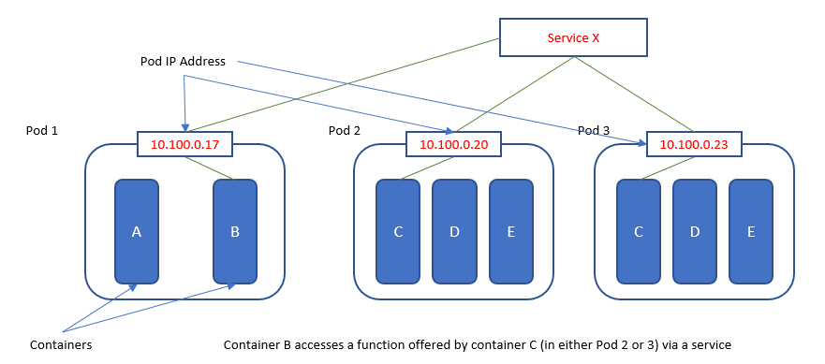
Things to Know

Slide 22
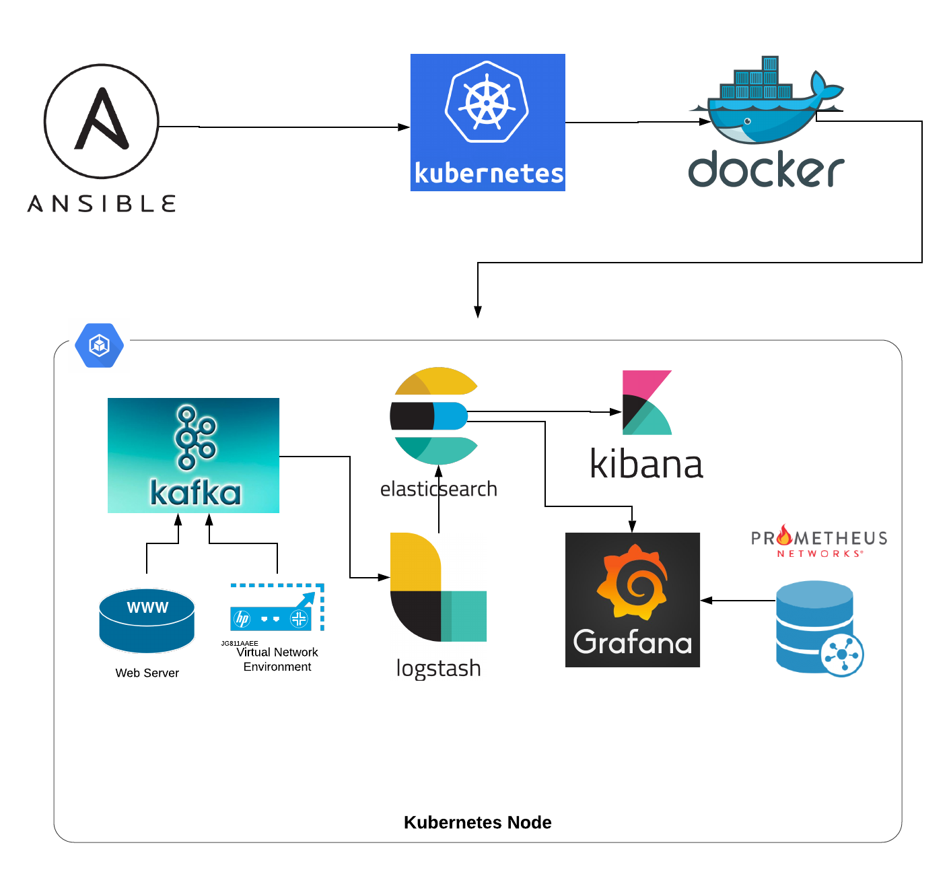
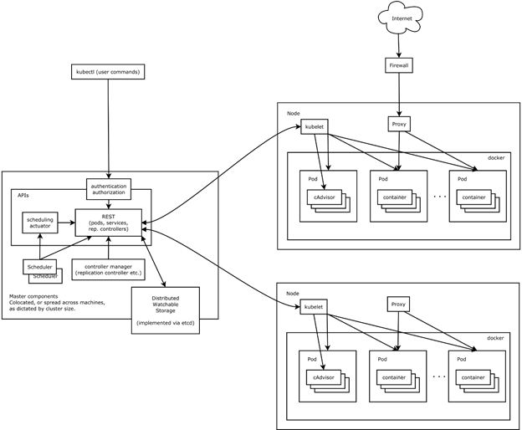
Things to Know
Source: The awesome 2019 InteropNet team.
Source: https://www.xoriant.com/blog/wp-content/uploads/2016/07/Kubernetes-Part2-Building-Blocks2.png

Slide 23
Things to Know Data Retention, Storage and Persistence
Containers store data and information as long as they live. When the container goes away, so does the data. Containers are really good for performing tasks.
To store data, use Portworx (or similar) to attach persistent storage to your pods. In this way the pod (service) can be configured to send output to persistent storage that can be read from and written to later.

Slide 24
Things to Know Docker - Build or Borrow???
Docker images are self-contained applications (containers). Think of these containers as fully packaged virtualized applications. For example you can build a portable image for a network monitoring system that has the front-end web interface AND the back end database, all neatly packaged and not dependent on the underlying operating system…AND portable between platforms.
You can build your own Docker containers. This gives you certainty of the build and work product, but can be time consuming.
You can “borrow” Docker images. Similar to GitHub (and often in parallel with) there is a robust community of developers that contribute to Docker Hub → https://hub.docker.com/.

Slide 25
Take Our Stuff
I'm not asking you to play rocks. I'm asking you to collaborate on a research project.
-Bert

Slide 26
Take Our Stuff
GitHub → https://github.com/InteropDemo/
Kibana → http://kibana.interop19.interop.net:5601/app/kibana

Slide 27
You Do It Lightbulb Challenge
This plasma grenade…Look! It’s raining you.
-Penny

Slide 28

Lightbulb Challenge Using DevOps Make Lights Change Color
Download / VirtualBox (no cost)
Download / Install Docker (no cost)
Set up a network device
GNS3 image
ssh to csr.interop19.interop.net – interop/interop19
Physically connect to our switches
Clone to our GitHub - https://github.com/InteropDemo/interop19-docker
Make Docker container
Reference and tweak lightbulb.yml in your Docker instance
More details at → https://github.com/InteropDemo/interop19-ansible
We are here to help and answer questions!!!

